Slide 1
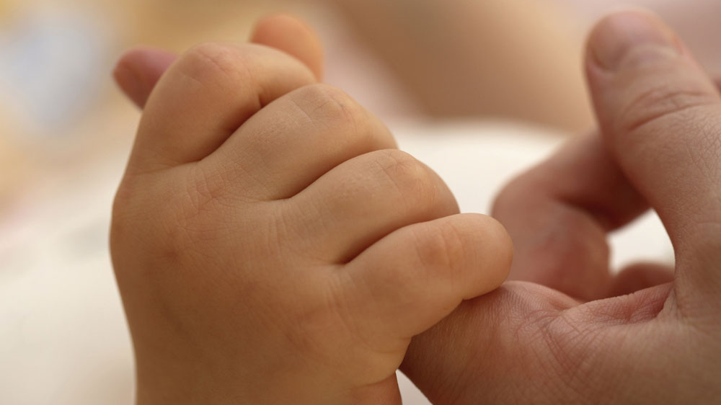
A CONSTRUCTIVE MANIPULATION OF FACIAL IMAGE POCESSING
S.VIJAY PALANIAPPAN MENTOR
115004130 PROF.K.NARASIMHAN

Slide 2
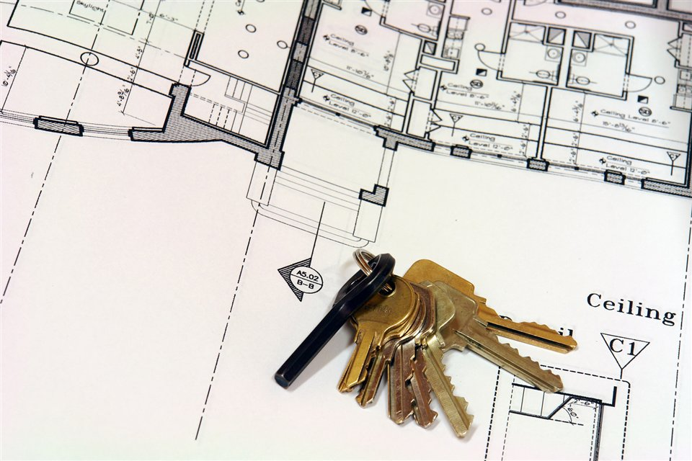
INEVITABILITY OF THE PROJECT
The societal issues constitute:
Surveillance Disruption
Issues due to lack of access control
Ineffective tools to track lost people
Lack of authorization of Age Restricted Community
Non-existence of electronic customer relationship

Slide 3

FACIAL IMAGE PROCESSING
An image is worth thousand words!
A face reveals plethora of unleashed facts
Exploration of facial images is quite complex
The features of a face image is the area of operation
Novel techniques in age and gender estimation

Slide 4
AGE ESTIMATION
This involves strenuous phenomenon
Simple and robust metrics is incorporated
Age estimation is based on 5 categories
Kids fall under 18 years old
Youths fall between 19 – 25 years old
Adults fall under 26 – 35 years old
Middle Aged fall under 36 – 50 years
Old people fall above 50 years old

Slide 5
NOVEL METRICS FOR AGE ESTIMATION
Computing the angle of the irises and mouth centre based triangle
Computing the angle of the irises and nose tip based triangle
Determining the distance between the irises
Determining the distance between the corners of the lip

Slide 6
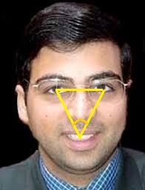
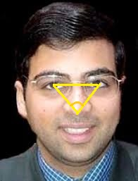
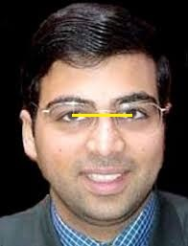
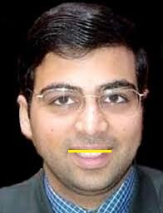
METRICS OVERVIEW
Irises-Mouth Angle Irises-Nose Tip Angle
Irises Distance Lip corners Distance

Slide 7
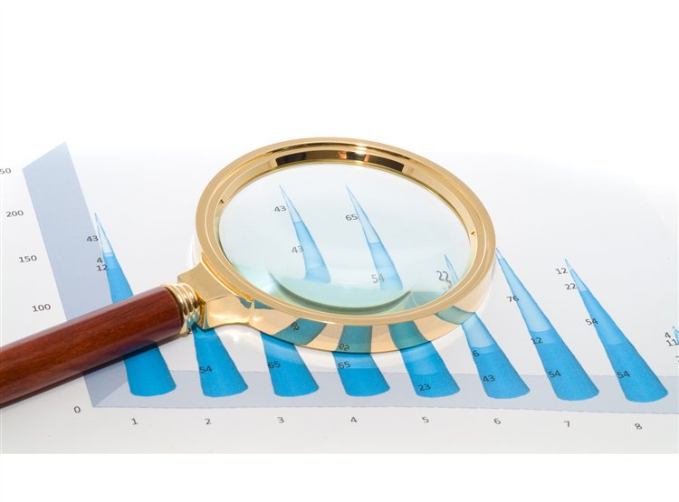
CHOICE OF CLASSIFIER
In order to have robust age estimate results, a classifier should be used
SVM classifier invokes ambiguity in the choice of kernels and memory requirements are high
KNN classifier is a slow learner of training samples and yields poor results
NN classifier tool does the intended classification and gives better results

Slide 8
PROTOCOL OVERVIEW
The implementation is carried out in the software Matlab 2013 ra
For locating the points, ginput() function is used
After computation, uiwait(msgbox()) function is used to display results
The four reliable metrics is processed by the NN Classifier tool
The process is repeated thrice to acquire robust results

Slide 9


Slide 10
GENDER CLASSIFICATION IDEAS
In facial image processing, gender identification is a tiresome task
Qualitative differences might give better dimension
The size of a male’s nose is 10% larger than that of a female’s nose
The shape of the head is circular/oval for female where it is a kind of rounded rectangle for male
There are a few more quantitative feature measures that makes a difference

Slide 11

THANK YOU

